Slide 1
AuthGen : Invisible Watermark

Slide 2
Overview
AuthGen stands as a cutting-edge initiative in the realm of anti-counterfeiting, presenting a pioneering Invisible Watermark that amalgamates multiple technologies seamlessly. At its core, AuthGen aspires to introduce a revolutionary QR code-like print-scan authentication service. This innovative approach involves the strategic use of Steganography, a technique dedicated to concealing information within non-secret data, ensuring the existence of the embedded message remains undetected. In the digital landscape, this technique often finds application in embedding secret messages within images, audio files, or various other media types.

Slide 3
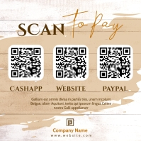

Difference between QR Codes and Invisible Watermark

Slide 4
Difference between QR Codes and Invisible Watermark
Aesthetics
Better security
Adjustable levels of fault-tolerance
Can differentiate between original print and duplicates

Slide 5
Problem of anti-counterfeiting
A projected estimate in 2021 puts the total monetary value of counterfeiting goods in 2023 at 3 trillion USD globally. Some of the largest affected companies include Amazon, Nike and Pfizer. Counterfeiting could include simple case of shoes to medical equipment, which could pose threat to someone’s life.

Slide 6
Existing solutions and their problems
RAIL RFID - expensive, can only track product till it is in a known store, easily hacked (Used by NIKE)
Uniquely Generated Invoices - cheap, but very easy to replicate
EM Tags (NFC) - require specialized hardware to read them, can only track products within store to store, easily hacked

Slide 7
Problems solved by Invisible Watermarking
Cheap
Virtually 0 delay in production line
No additional hardware required
Reliable
Can differentiate between duplicate and original product
All you need is any phone with a camera and internet

Slide 8
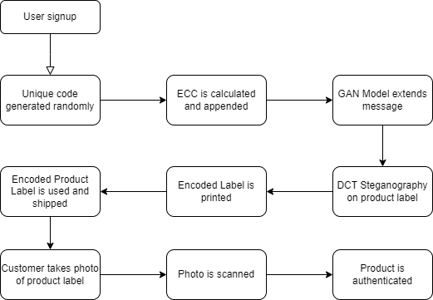
How does Invisible Watermark work?

Slide 9
What is Steganography?
Steganography is the practice of concealing information within seemingly ordinary media to safeguard its confidentiality and integrity. It involves embedding data in various digital or physical carriers, such as images, audio, video, or text, with the goal of covert communication or protecting sensitive information. Steganographic techniques, like LSB replacement in images or frequency domain embedding, ensure that the hidden data remains undetected to unauthorized users.

Slide 10
LSB Steganography
LSB Steganography replaces the Least Significant Bit of a byte in cover data with the bit of secret message.
Original file: 11111111 00000000 11111111 00000000
Secret message: 0101
Encoded byte: 11111110 00000001 11111110 00000001

Slide 11
DCT Steganography
DCT (Discrete Cosine Transform) steganography operates by embedding information in the frequency domain of images through slight alterations in the coefficients, ensuring hidden data is imperceptible to the human eye and resistant to common detection methods.

Slide 12

DCT Steganography

Slide 13
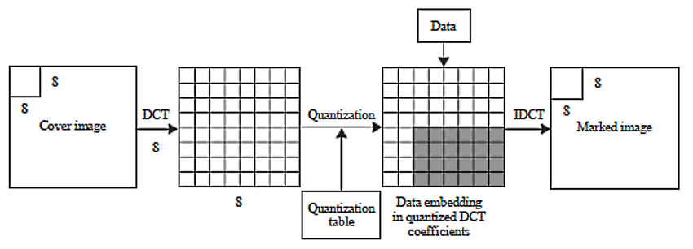
DCT Steganography

Slide 14
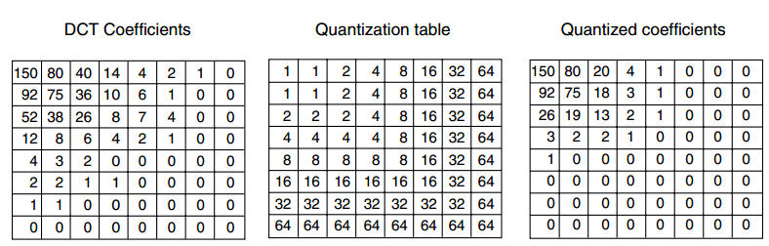
DCT Steganography

Slide 15
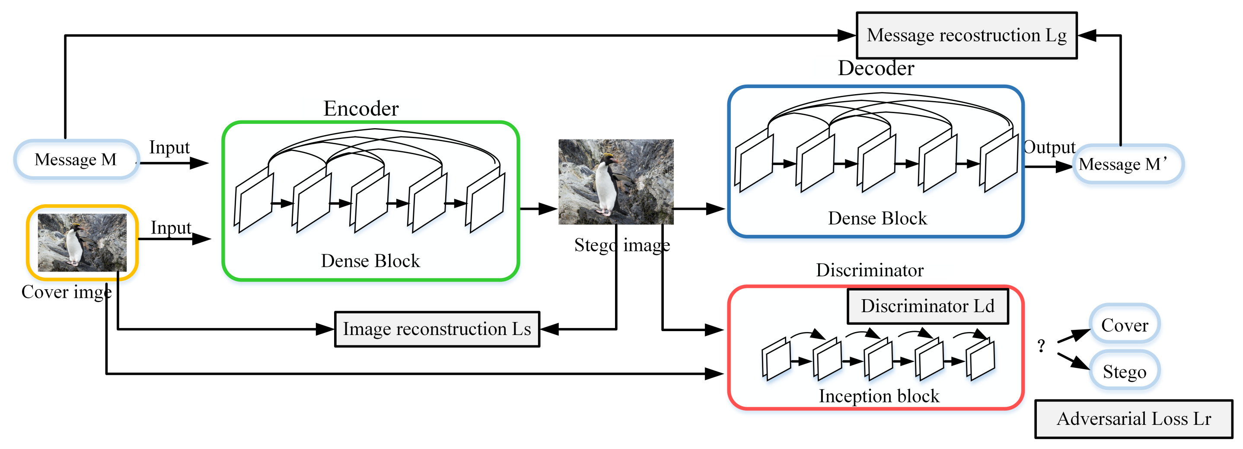
GAN Steganography

Slide 16
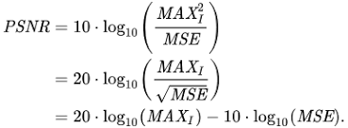
GAN Steganography

Slide 17
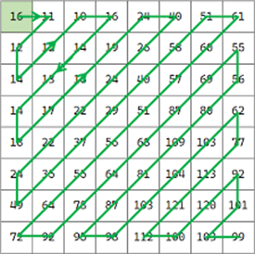
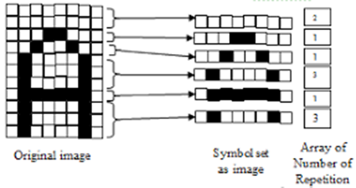
Security Features
Safeguard against scanning

Slide 18
Security Features
Adjustable fault-tolerance
Dynamic Watermarking, with statistical analysis

Slide 19


Results

Slide 20


Slide 21

5% Blur - PASSED

Slide 22
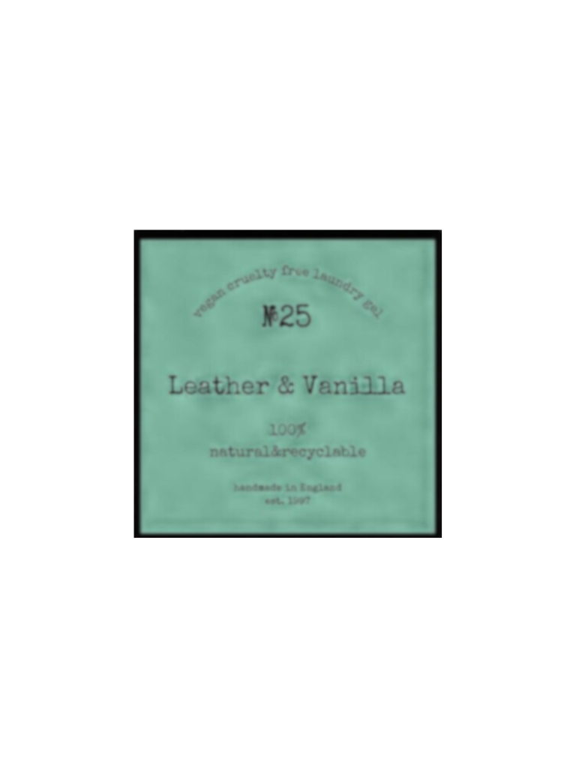
15% Blur - PASSED

Slide 23

45% Blur - PASSED

Slide 24
15% Blur 5% Duotone - PASSED

Slide 25
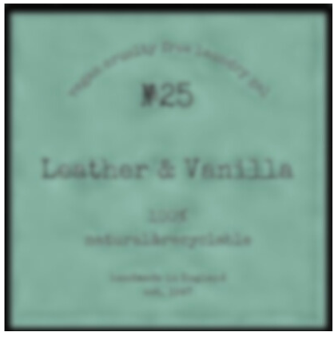
30% Blur 15% Duotone - PASSED

Slide 26
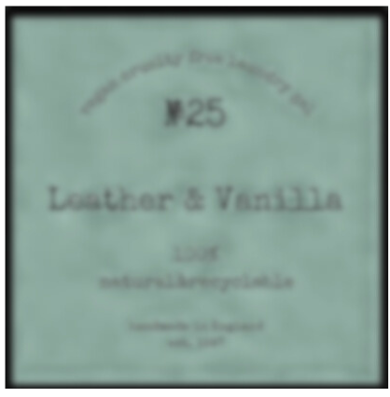
30% Blur 30% Duotone - PASSED

Slide 27

30% Blur Irregular Focus - PASSED

Slide 28
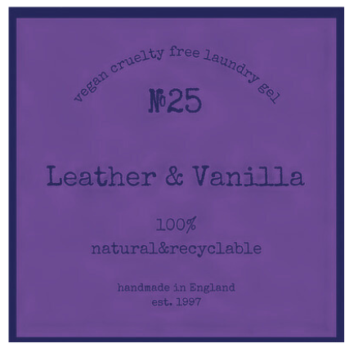
Complete Color Shift - PASSED

Slide 29

60% Blur - FAILED

Slide 30

Real-time example - PASS

Slide 31
How is this possible?
We combine the reliability of BCH Error Correction of burst and localized errors, encoding capabilities of DCT Steganography which makes it invulnerable to environmental factors and the artifact reduction capabilities of GAN Steganography.

Slide 32
Software requirements
To run the servers concurrently, we recommend using Intel i5 or AMD Ryzen 5 paired with Nvidia GeForce GTX 1650 Ti. This setup can be done over the cloud and can replace the GPU with any commercially available TPU for lesser request turnaround time.

Slide 33
Hardware requirements
For any client employing our services, the product label can use any commercial printer to print their label. For example purposes, we used Canon PIXMA G4770. Industrial scanners will result in better performance.
For the end customer, any basic camera above 5 MP can be used to take the picture. For example purposes, we use Vivo X60 to capture the image.

Slide 34
Thank you

